Slide 1

Maven Coffee Sales: Data-Driven Insights for Smarter Retail Decisions
Exploring sales data to optimize retail performance and customer engagement.

Slide 2

Project Objectives
Understand Sales Trends
Location and time-based performance insights
Identify High-Performing Products
Top sellers and revenue drivers
Evaluate Customer Behavior
Purchasing patterns and preferences
Provide Actionable Insights
Optimize sales and store operations

Slide 3
Dataset Overview
Source & Period
Key Features
Maven Coffee Retail Dataset, Jan 2023 to [End Period]
11 columns: transactions, store, product, pricing
Over [insert transaction count] transactions
Multiple categories: Coffee, Tea, Hot Chocolate

Slide 4

Total Revenue & Average Order Value
Total Revenue
Average Order Value (AOV)
$698812.33 representing overall sales volume
$4.69 per transaction indicating spend behavior
Headline Metrics
Crucial indicators of business health and growth potential

Slide 5
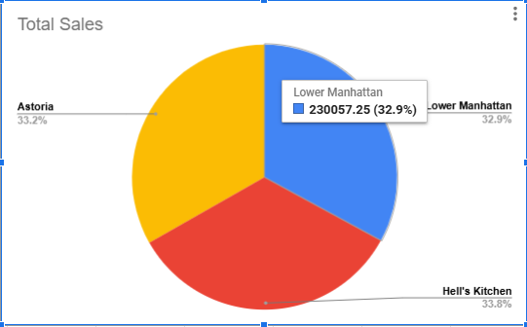
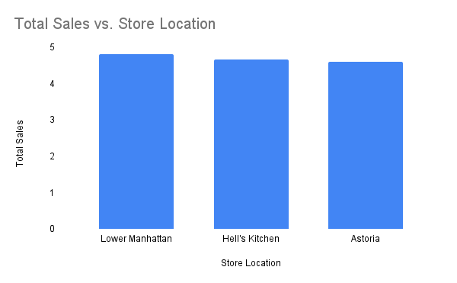
Store Performance
Top Performing Store
Avg Transaction Value by Store
Lower Manhattan | 4.81
Hell's Kitchen | 4.66
Astoria | 4.59

Slide 6

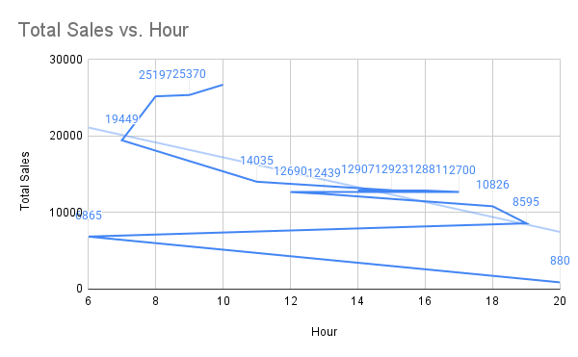

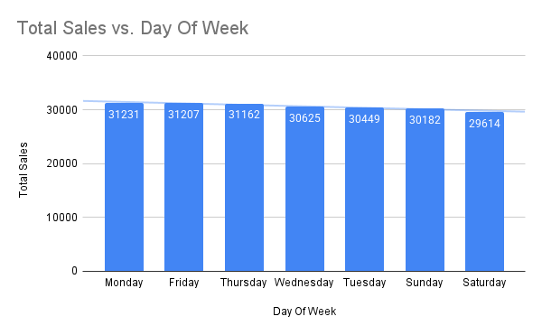

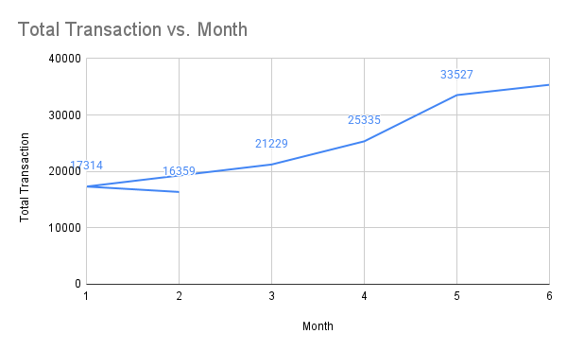

Time-Based Sales Trends
Peak Hours
Most transactions at 10 AM
Monthly Trend
Analyzing stability and seasonality in sales
Day of Week
Monday and Friday highest sales volume

Slide 7
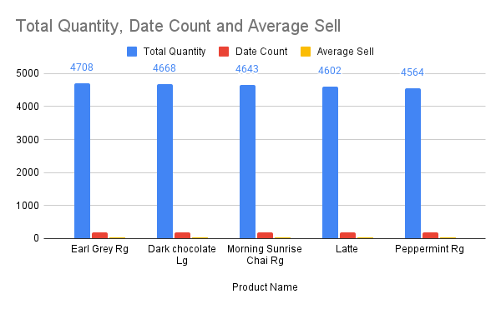
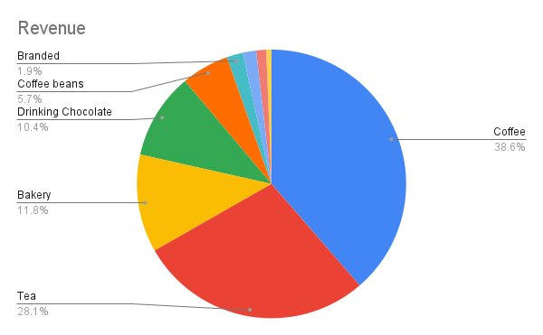
Product Insights
Revenue per Unit
Top Products
Best Categories
Product Name | Revenue Per Unit
Civet Cat | 45.00
I Need My Bean! T-shirt | 27.89
Organic Decaf Blend | 22.61
Ethiopia | 21.00
Primo Espresso Roast | 20.45
Jamacian Coffee River | 19.75
Brazilian - Organic | 18.00
Our Old Time Diner Blend | 18.00
Columbian Medium Roast | 15.00
Espresso Roast | 14.75

Slide 8
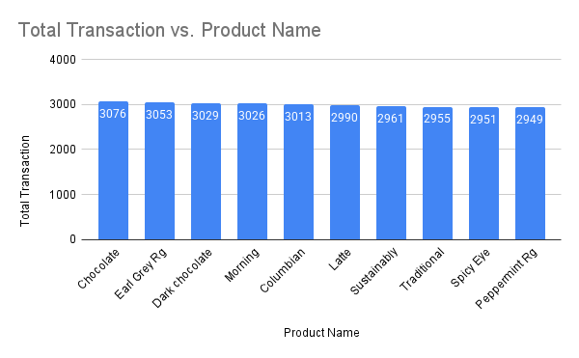
Customer Behavior (Inferred)
Items per Transaction
High-Frequency Products
$1.44 items averaged

Slide 9
Key Business Takeaways
Focus marketing on top-selling times and days
Promote premium high-revenue products
Tailor strategies to store locations
Use AOV to set free shipping thresholds
Expand offerings in best-selling categories

Slide 10





Next Steps & Recommendations
Customer Segmentation
Explore if customer data available
Product Bundling
Analyze basket combinations
Seasonal Trends
Leverage event-based data
Staffing Optimization
Adjust around peak hours
Pricing Testing
Adjust low-revenue items

Slide 11
Thank You
Follow me on:
Linkedin- https://www.linkedin.com/in/rohanur-rahman-ontu/
Github- https://github.com/ontu001
Medium- https://medium.com/@playwithdatawithontu

